Slide 1
Transformers are GNNs
Jason Chang

Slide 2
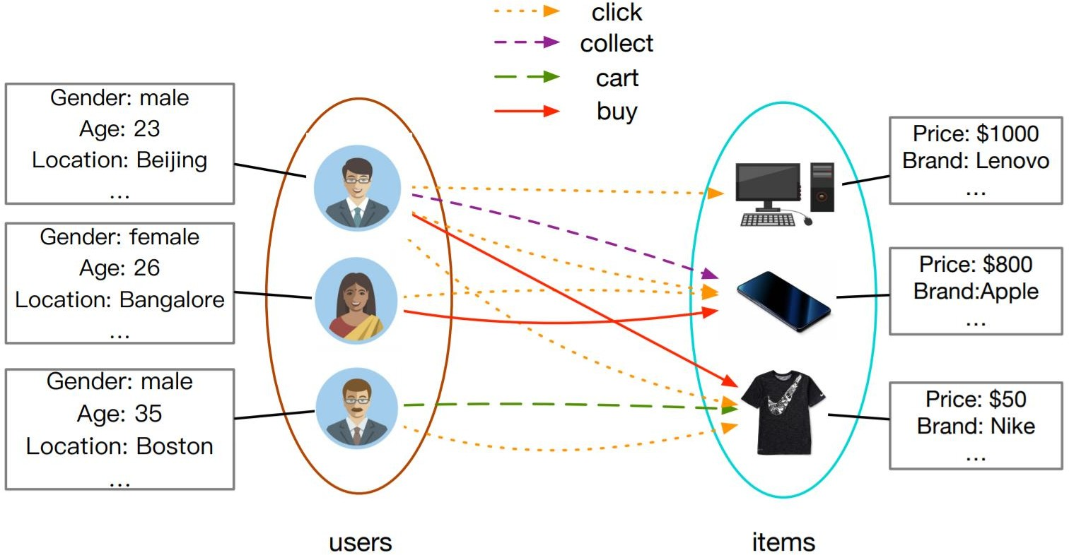
Some success stories: GNNs for RecSys

Slide 3
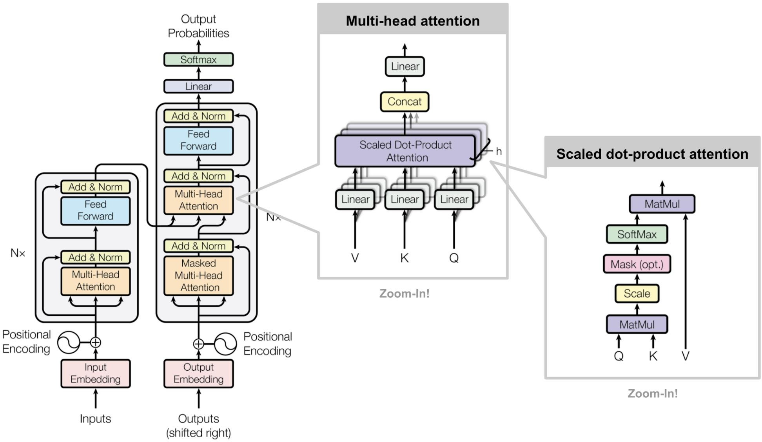
Another success story? The Transformer architecture for NLP

Slide 4
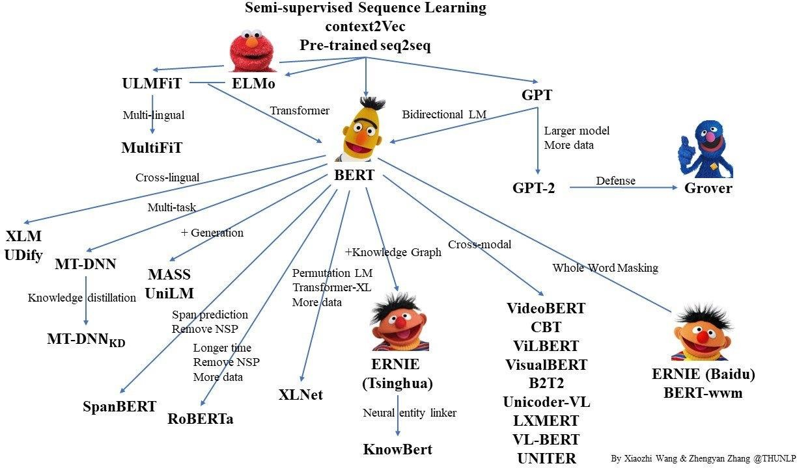
BERT family

Slide 5
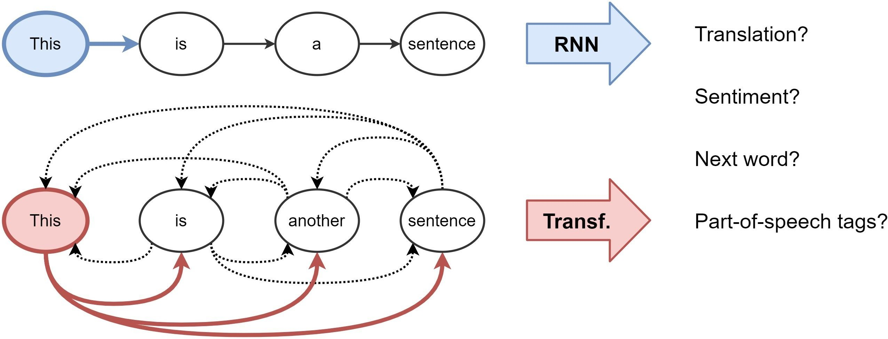
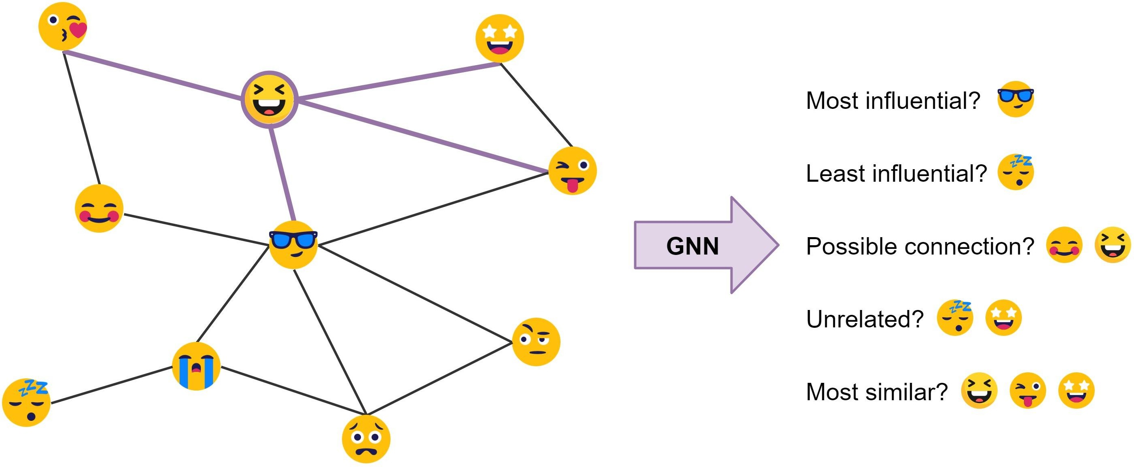
Representation Learning
NLP
Graph

Slide 6
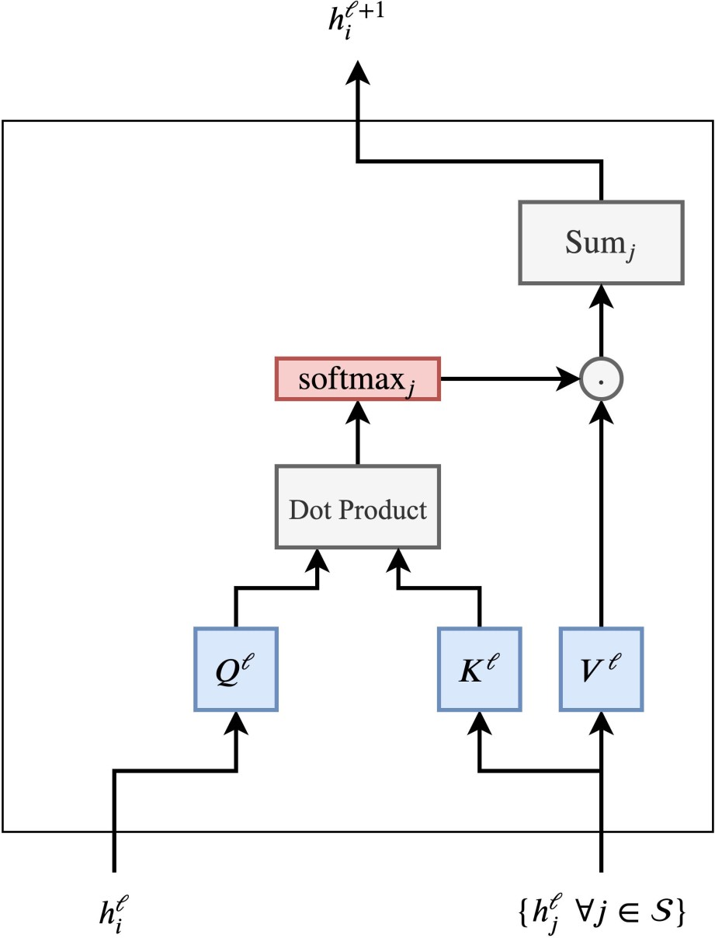
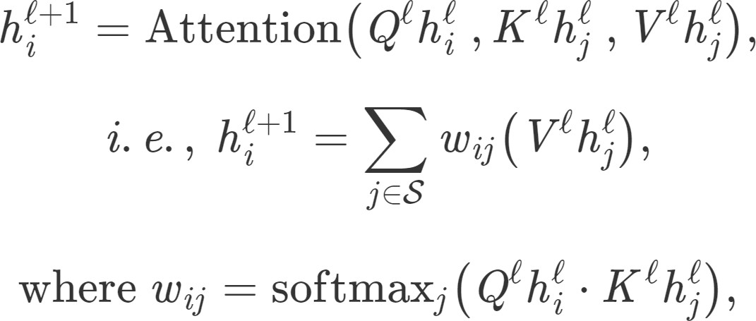
Breaking down the Transformer
We update the hidden feature h of the i'th word in a sentence S from layer ℓ to
layer ℓ+1 as follows:
where j∈ S denotes the set of words in the sentence and Q, K, V are learnable linear weights.

Slide 7
Breaking down the Transformer
We update the hidden feature h of the i'th word in a sentence S from layer ℓ to
layer ℓ+1 as follows:
where j∈ S denotes the set of words in the sentence and Q, K, V are learnable linear weights.

Slide 8
Breaking down the Transformer
We update the hidden feature h of the i'th word in a sentence S from layer ℓ to
layer ℓ+1 as follows:
where j∈ S denotes the set of words in the sentence and Q, K, V are learnable linear weights.

Slide 9
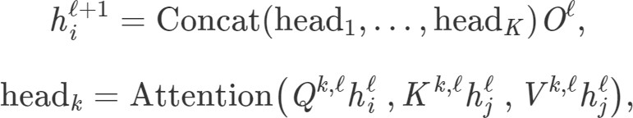
Multi-head Attention
Bad random initializations can de-stabilize the learning process of this dot-product attention mechanism. We can ‘hedge our bets’ through concatenating multiple attention ‘heads’:

Slide 10
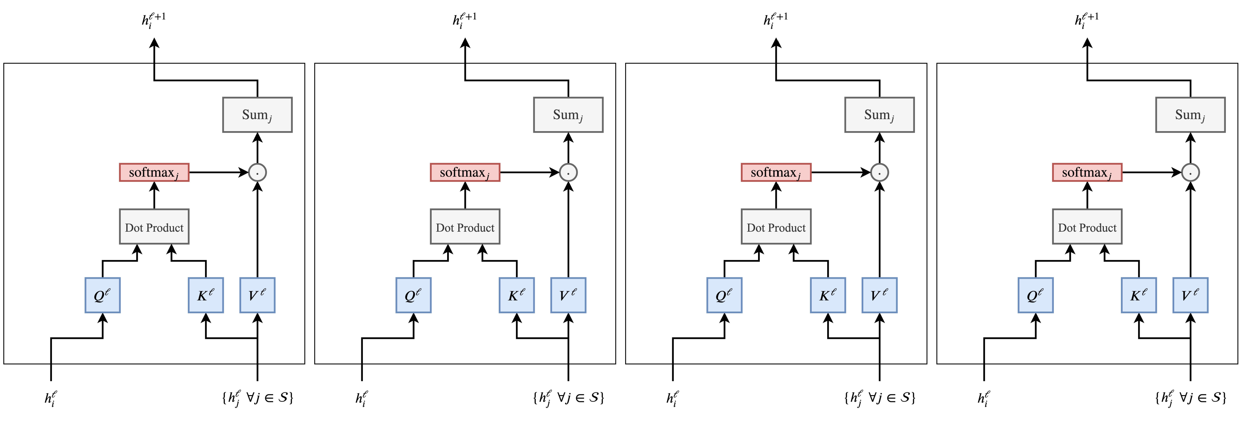
Multi-head Attention

Slide 11
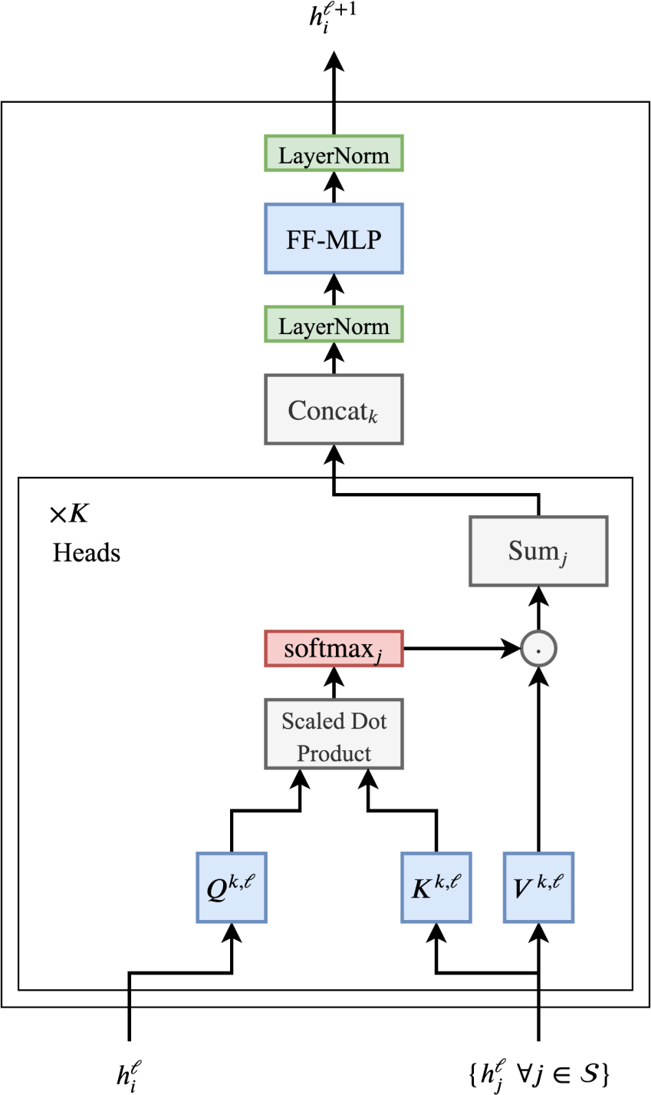
The Final Picture
Update each word’s features through Multi-head Attention mechanism as a weighted sum of features of other words in the sentence.
+ Scaling dot product attention
+ Normalization layers
+ Residual links

Slide 12
The Final Picture
Update each word’s features through Multi-head Attention mechanism as a weighted sum of features of other words in the sentence.
+ Scaling dot product attention
+ Normalization layers
+ Residual links

Slide 13
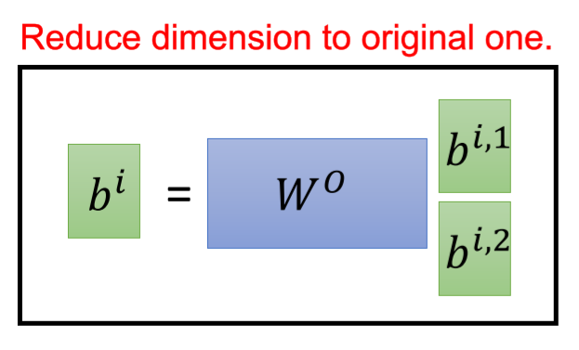
The Final Picture
Update each word’s features through Multi-head Attention mechanism as a weighted sum of features of other words in the sentence.
+ Scaling dot product attention
+ Normalization layers
+ Residual links

Slide 14
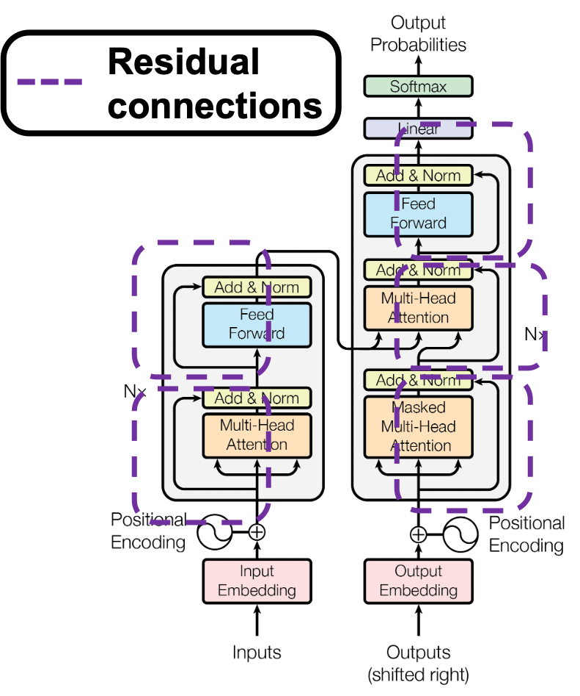
The Final Picture
Update each word’s features through Multi-head Attention mechanism as a weighted sum of features of other words in the sentence.
+ Scaling dot product attention
+ Normalization layers
+ Residual links

Slide 15
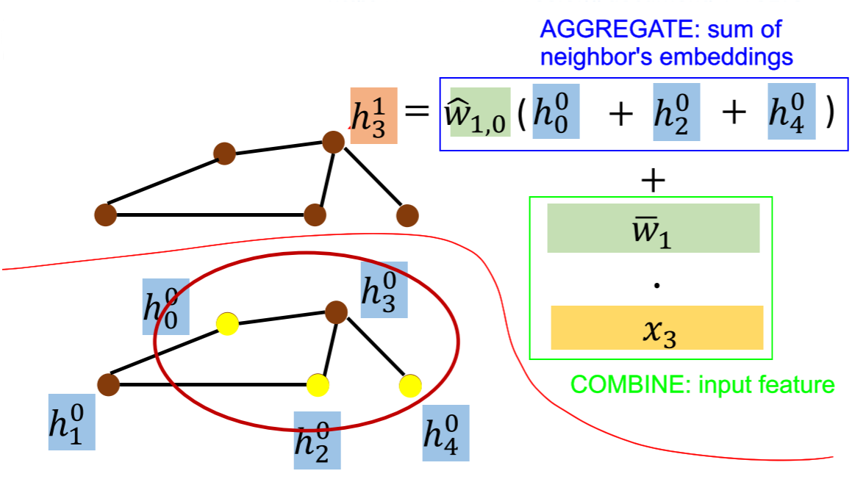
Graph Neural Networks

Slide 16
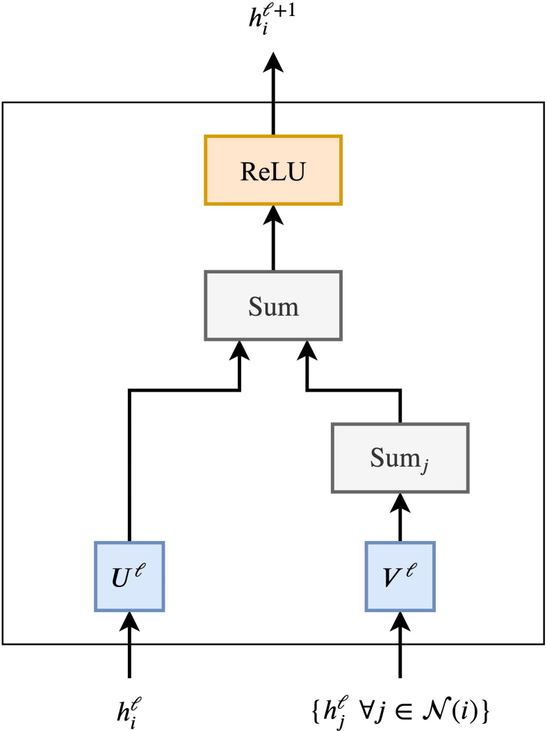
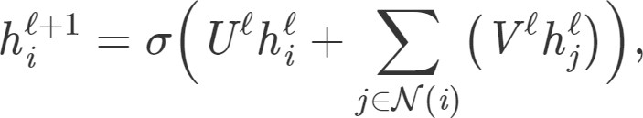
Graph Neural Networks
GNNs update the hidden features h of node i at layer ℓ via a non-linear transformation of the node’s own features added to the aggregation of features from each neighboring node j∈ N(i):
where U, V are learnable weight matrices of the GNN layer and σ is a non-linearity.

Slide 17
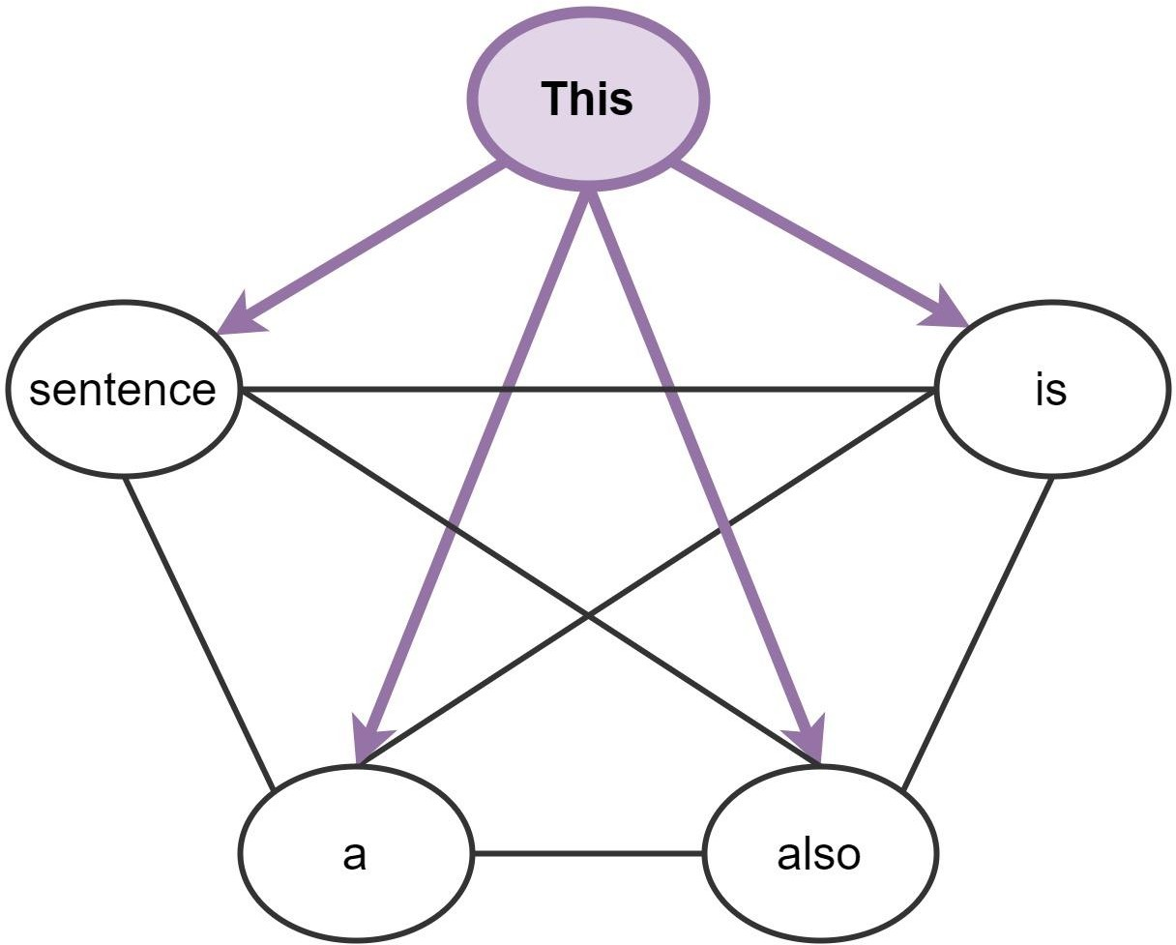
Connections b/w GNNs and Transformers
Consider a sentence as a fully
connected graph of words…
This is also a sentence

Slide 18
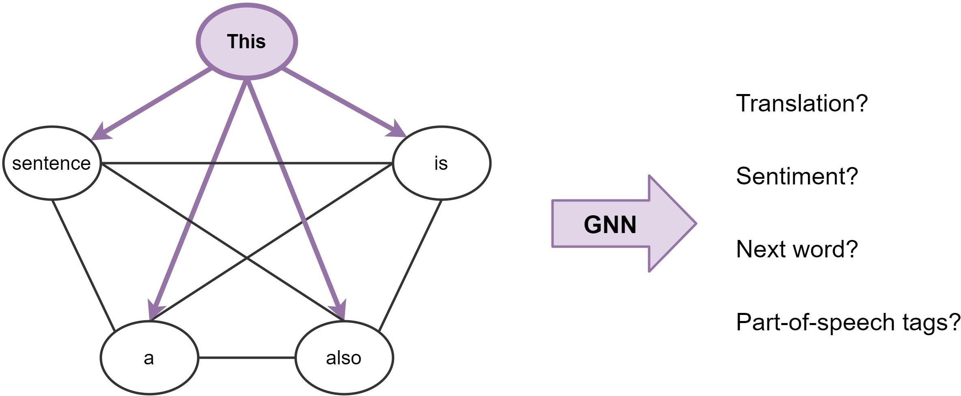
Connections b/w GNNs and Transformers

Slide 19
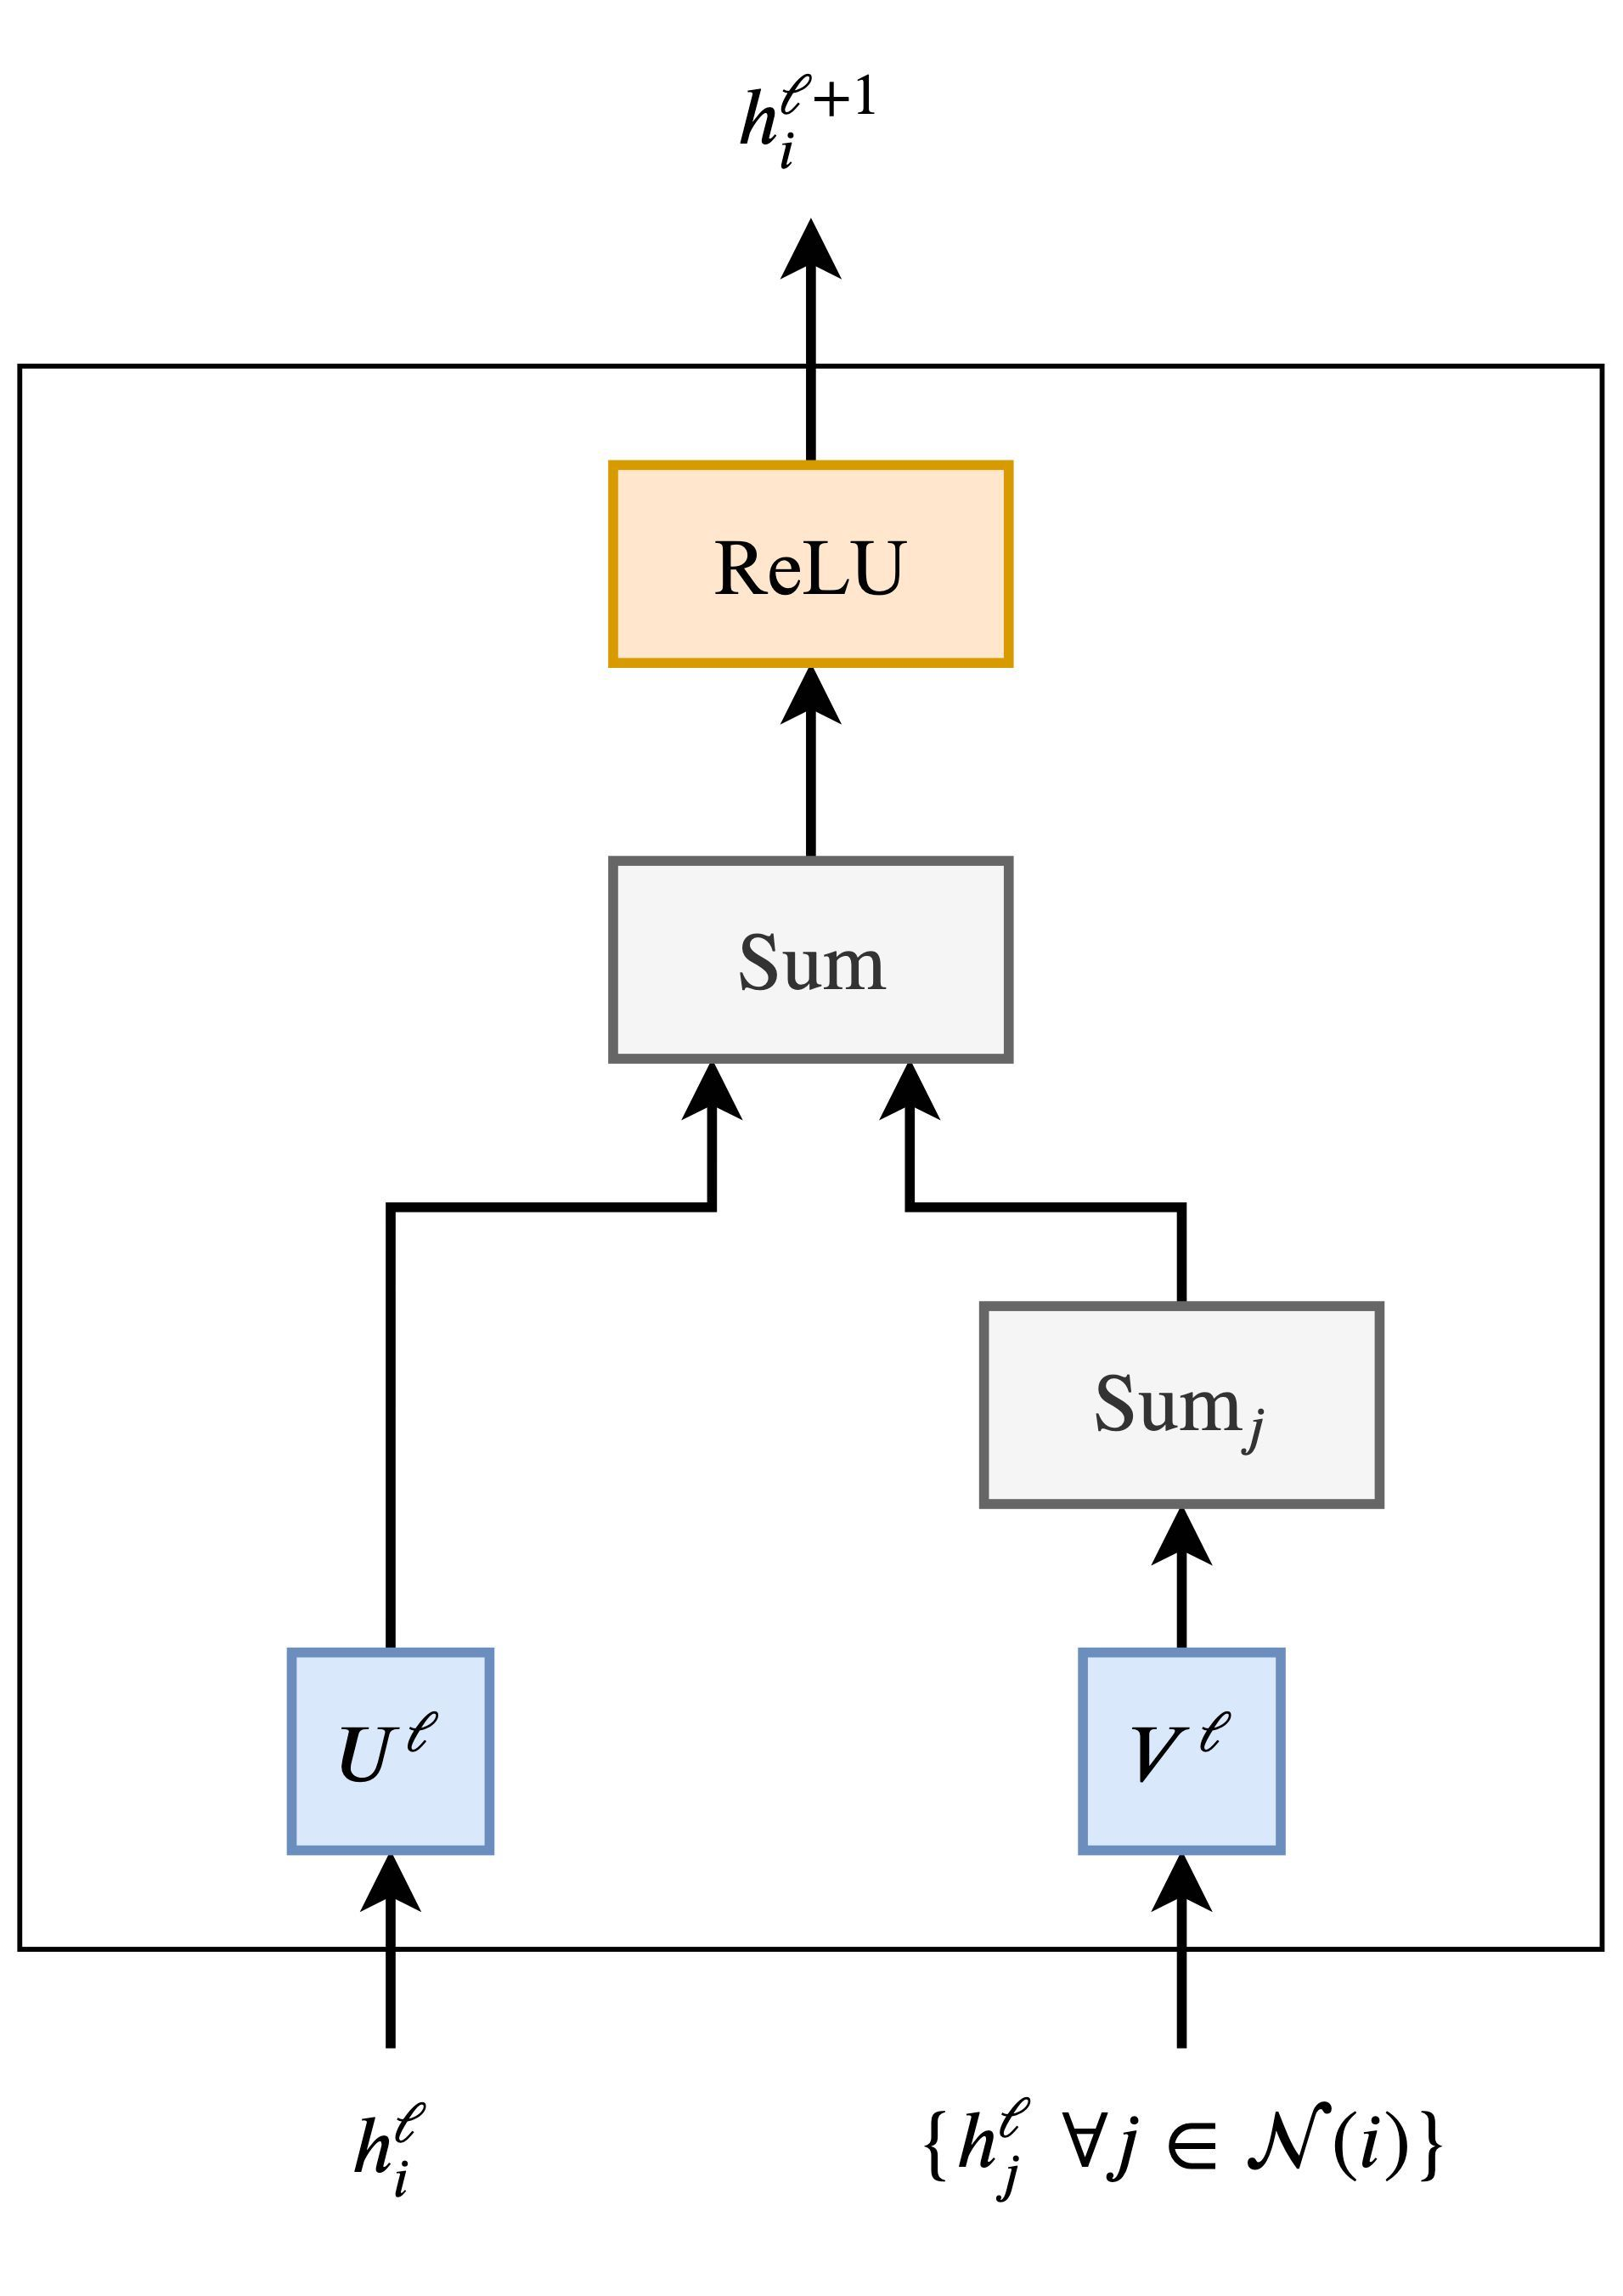
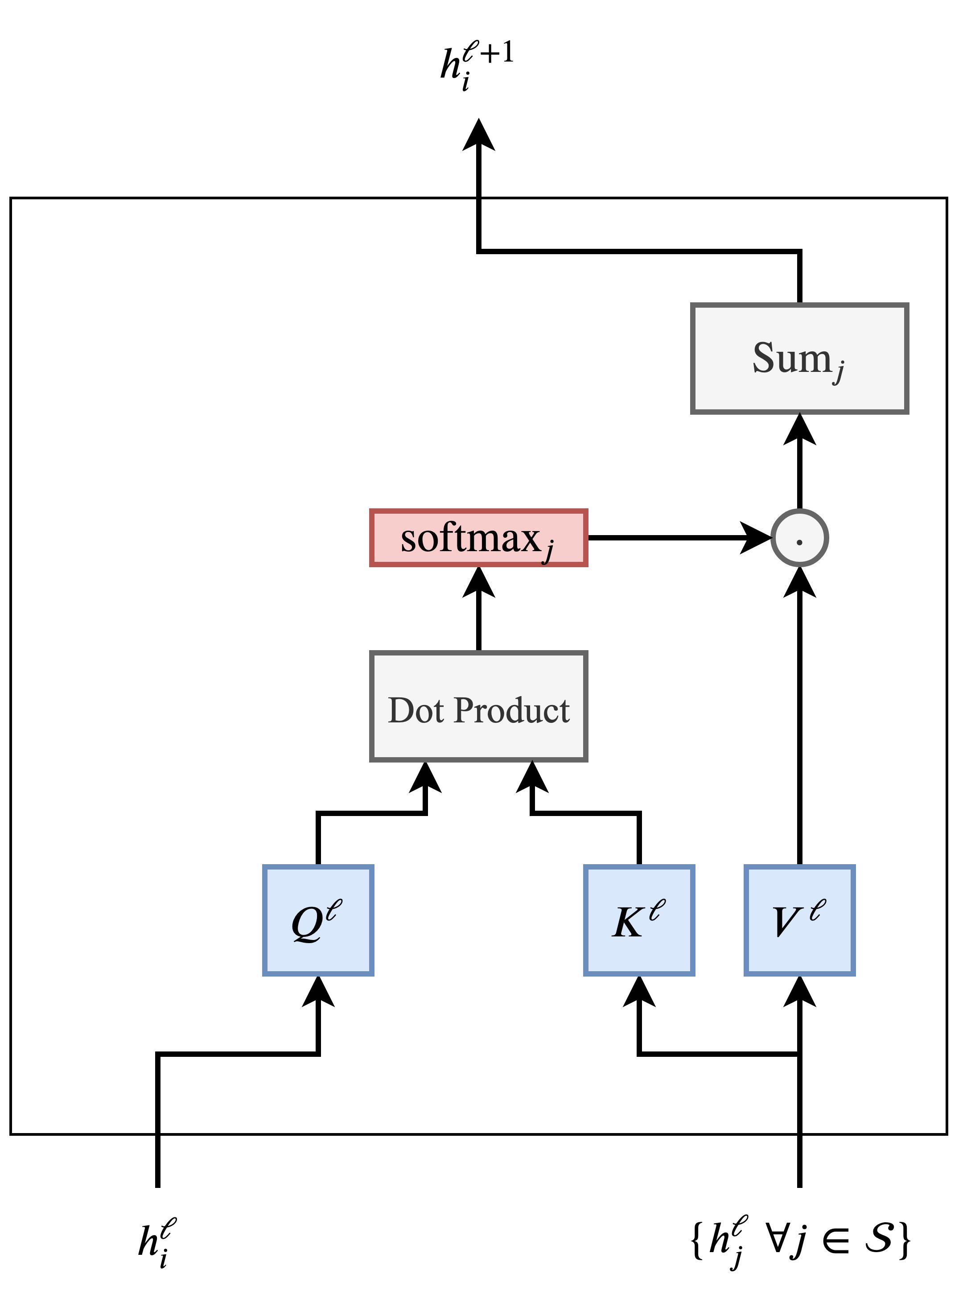
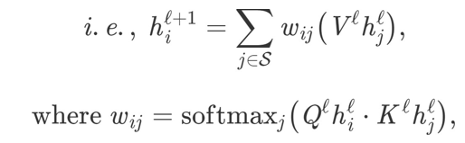
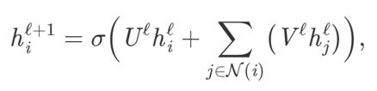
Connections b/w GNNs and Transformers
Self-attention
GNN

Slide 20
Connections b/w GNNs and Transformers
Self-attention
GNN
Sum over local neighborhood
Sum over all words in S

Slide 21
Connections b/w GNNs and Transformers
Self-attention
GNN
Simple linear transform and sum
Weighted sum via attention

Slide 22
Transformer
GNN
Self-attention
+ Weighted sum aggregation
+ Multi-head mechanism
+ Normalization layers
+ Residual links

Slide 23

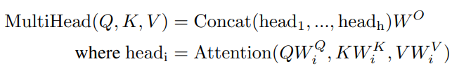


Transformer
GNN
Self-attention
+ Weighted sum aggregation
+ Multi-head mechanism
+ Normalization layers
+ Residual links

Slide 24
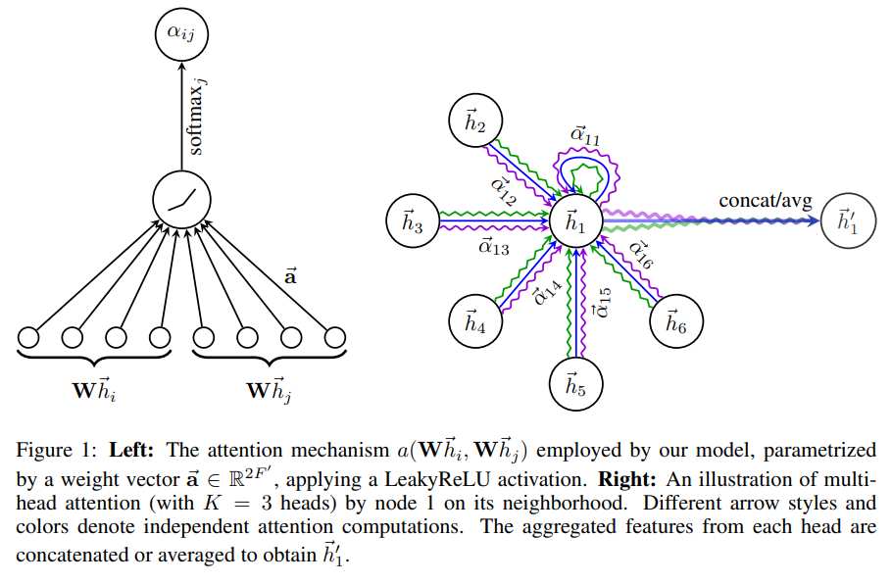
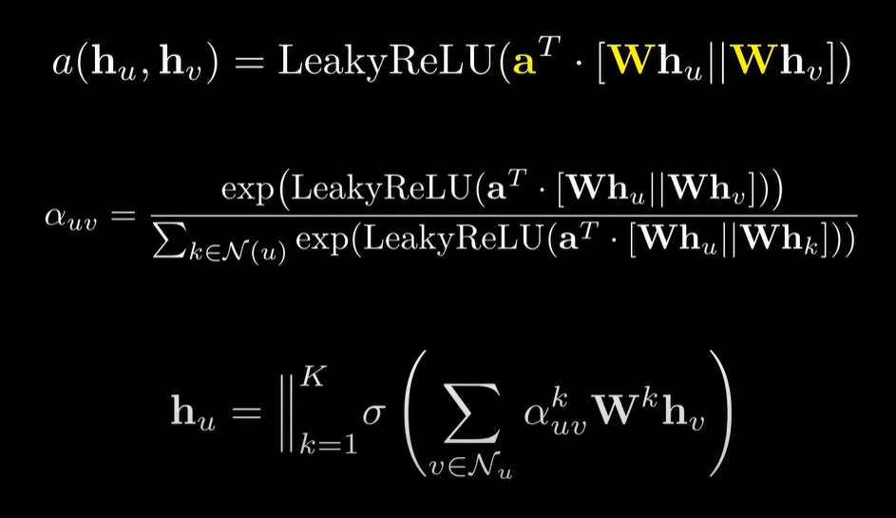
Transformer
GNN
Self-attention
GAT
+ Weighted sum aggregation
+ Multi-head mechanism
+ Normalization layers
+ Residual links

Slide 25
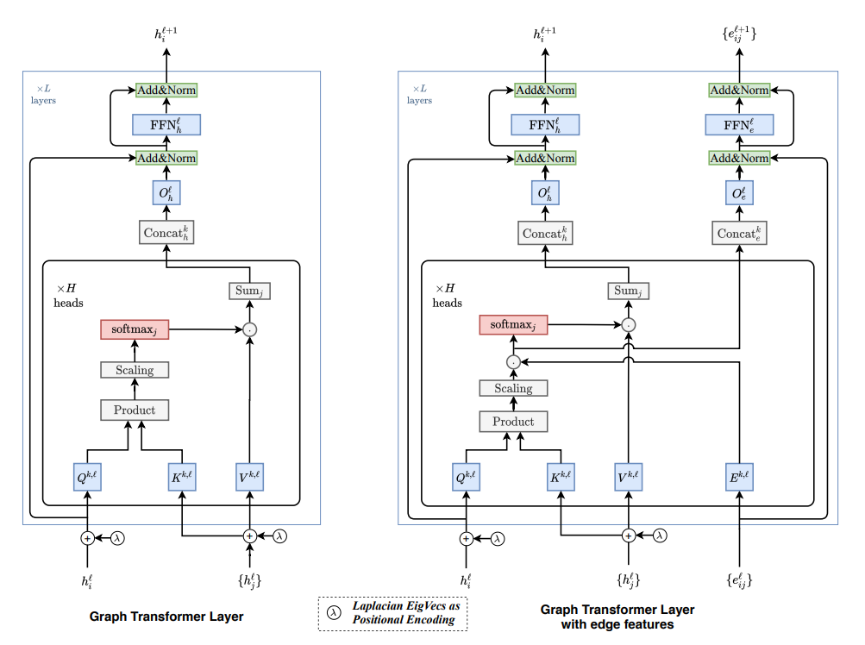
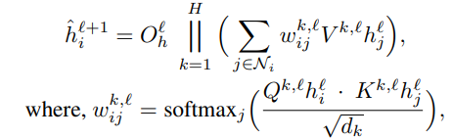
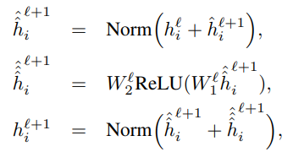
Graph Transformer

Slide 26
Thanks for your attention

